Slide 1



STAR-GALAXY CLASSIFICATION USING DEEP LEARNING
BY
AJAY DAS M
S3MCA
MAC23MCA-2008

Slide 2
INTRODUCTION
LITERATURE REVIEW 1
LITERATURE REVIEW 2
LITERATURE REVIEW 3
SUMMARY
PROJECT PROPOSAL
CONCLUSION
Overview

Slide 3
Introduction
The challenge of accurately classifying astronomical objects as stars or galaxies has been a fundamental task in astrophysics for centuries.
Traditional methods relied heavily on visual inspection and morphological analysis, which were labour-intensive and limited by human subjectivity and the capacity to process large data volumes.
With the advent of modern sky surveys like the Sloan Digital Sky Survey (SDSS), the volume of astronomical data has grown exponentially, rendering manual classification impractical.

Slide 4
Introduction
The proposed system uses Convolution Neural Network (CNN). The models will classify photometric data under two classes Star. An automated system with the help of deep learning methodology we can make these much easier.
The models will classify photometric data under two classes Star and Galaxy. An automated system can be very helpful to offers significant benefits for star-galaxy classification, including reduced human error, increased scalability, and efficient handling of vast data quantities

Slide 5
LITERATURE REVIEW 1
Ganesh Ranganath Chandrasekar Iyer Krishna Chaithanya Vastare (2017). Deep Learning for Star-Galaxy Classification
TITLE | YEAR | DATASET | ARCHITECTURE ARCHITECTURE | ACCURACY
Deep Learning for Star-Galaxy Classification | 2017 | Dataset was taken from the Sloan Digital Sky Survey (SDSS). The dataset contains 30 million images. | Convolutional Neural Networks(CNN) | 99.19

Slide 6
LITERATURE REVIEW 2
Kim EJ, Brunner RJ. Star-galaxy classification using deep convolutional neural networks. Monthly Notices of the Royal Astronomical Society. 2016 Oct 17:stw2672.
TITLE | YEAR | DATASET | ARCHITECTURE ARCHITECTURE | ACCURACY
Star-galaxy classification using deep convolutional neural networks | 2016 | photometric and spectroscopic data sets with different characteristics and compositions. data sets and the image pre-processing steps for retrieving cutout images | Convolutional Neural Networks (ConvNets) | 99.48

Slide 7
LITERATURE REVIEW 3
Kennamer N, Kirkby D, Ihler A, Sanchez-Lopez FJ. ContextNet: Deep learning for star galaxy classification. In International conference on machine learning 2018 Jul 3 (pp. 2582-2590). PMLR.
TITLE | YEAR | DATASET | ARCHITECTURE ARCHITECTURE | ACCURACY
ContextNet: Deep Learning for Star Galaxy Classification | 2018 | The dataset used in the work consists of simulated images from the Large Synoptic Survey Telescope (LSST) observations, generated using the GalSim image simulation package. | Local Network: Convolutional Neural Networks (CNNs) Global Network: Recurrent Neural Networks (RNNs) Prediction Network: Fully Connected Neural Networks (FCNs) | ContextNet - 95%

Slide 8
LITERATURE REVIEW SUMMERY
REVIEW PAPER | ARCHITECTURE | ACCURACY
Deep Learning for Star-Galaxy Classification | Convolutional Neural Networks(CNN) | 99.19
Star-galaxy classification using deep convolutional neural networks | Convolutional Neural Networks (ConvNets) | 99.48
ContextNet: Deep Learning for Star Galaxy Classification | ContextNet | 95

Slide 9
DATA SET
The dataset is taken from the Kaggle repository, containing a collection of astronomical images captured using a 1.3-meter telescope located in Nainital, India.
The dataset contains 3986 sample observations, with 942 Galaxies and 3044 Stars photometric data.
Link : https://www.kaggle.com/datasets/divyansh22/dummy-astronomy-data/

Slide 10
PROJECT PROPOSAL
Objective
Develop a deep learning-based system for the accurate classification of astronomical objects as stars or galaxies, leveraging the benefits of reduced human error, increased scalability, and efficient handling of vast data quantities.
Methodology
Utilize Convolutional Neural Networks (CNNs) to build a binary classifier that can distinguish between stars and galaxies in photometric data. Implement data preprocessing, model training, and evaluation steps to optimize the classification performance.

Slide 11
DATASET EXPLORATION
SOURCE
This data was created as a part of my project at Aryabhatta Research Institute of Observational Sciences (ARIES), Nainital, India
The images were captured by the in-house 1.3m telescope of the observatory situated in Devasthal, Nainital, India

Slide 12
DATASET EXPLORATION
All image in the dataset are reduced to 64 x 64 cutouts from the images to isolate the sources in a single image.
CLASS LABELS
The dataset is labeled with 10 distinct ayurvedic plant Some of them are:
Star
galaxy

Slide 13
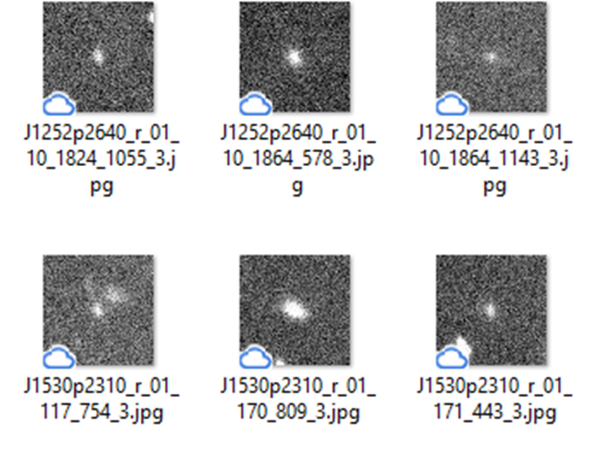
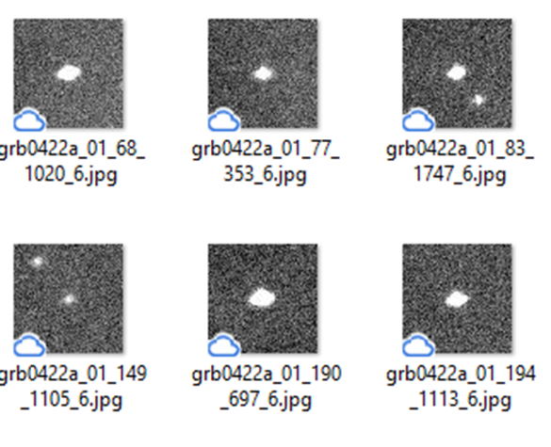
Galaxy Data Example
Star Data Example

Slide 14
DATA PREPROCESSING
RESIZE IMAGE
Uniform Image Size: Since CNNs require fixed-size input images, all images in the dataset must be resized to a uniform size. A common choice for this type of classification task is 64x64 or 128x128 pixels, although the size can be adjusted based on the computational resources available and the complexity of the objects in the images.
Aspect Ratio Consideration: Ensure that resizing doesn't distort the images, particularly if the original images have different aspect ratios. In some cases, padding the images to maintain aspect ratios might be necessary.

Slide 15
NORMALIZE
Pixel Value Scaling: CNNs perform better when input data is normalized. Typically, image pixel values are scaled from their original range (0-255 for 8-bit images) to a range of 0-1 or -1 to 1. This is done by dividing the pixel values by 255. Normalization helps in speeding up the convergence during training by ensuring that the input features have a similar scale.

Slide 16
Data Augmentation
Data augmentation artificially increases the size of the training dataset by creating modified versions of images in the dataset. This helps the model generalize better and become more robust to variations.
Technique:
Rotation: Randomly rotate images within a certain range to simulate different orientations of celestial objects.
Flipping: Horizontally or vertically flip the images to introduce symmetry variations.
Zooming: Randomly zoom in on images to simulate different scales.
Brightness/Contrast Adjustments: Modify the brightness and contrast of the images to account for different lighting conditions in the data.
Translation: Shift images horizontally or vertically to simulate positional variance.

Slide 17
Splitting the Database
Training Set: 80% of the dataset is used for training. This is the subset of data the model will learn from.
Test Set: The remaining 20% is reserved for testing the model after training to evaluate its performance on unseen data.

Slide 18
WORKING OF ALGORITHM
Convolutional Neural Networks (CNNs) are a class of deep learning models commonly used for image and video recognition
The main layers of CNN are:
Input Layer
Convolution Layer
Pooling Layer
Fully-Connected (dense)Layers
Output Layer

Slide 19
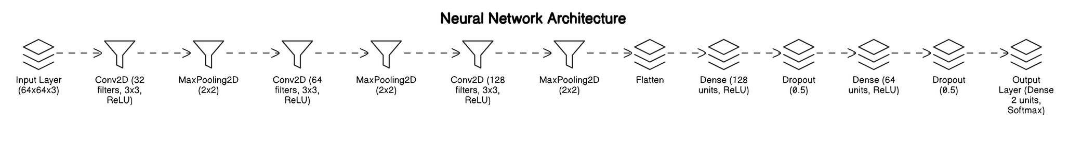
Architecture Diagram

Slide 20
1. Input Layer:
Function: Accepts the raw input images, which in this case are 44x44 pixel images in five photometric bands (u, g, r, i, z).
Role in the Project: Provides the initial data (images) to the network, which will be processed and analyzed to distinguish between stars and galaxies.

Slide 21
2. Convolutional Layers:
Function: Applies convolution operations to the input data, using a set of filters (kernels) to extract features such as edges, textures, and shapes.
Role in the Project: These layers detect various features at different levels of abstraction. Early layers might detect basic features like edges, while deeper layers detect more complex structures relevant to differentiating stars from galaxies.

Slide 22
4. Max-Pooling Layers:
Function: Reduces the spatial dimensions (width and height) of the feature maps, retaining the most critical information while reducing the computational load and controlling overfitting.
Role in the Project: By reducing the dimensionality, these layers help in abstracting the features detected by convolutional layers and make the network more computationally efficient.

Slide 23
5. Fully Connected (Dense) Layers:
Function: Each neuron in these layers is connected to every neuron in the previous layer, which allows the network to combine the features extracted by the convolutional and pooling layers and make final predictions.
Role in the Project: These layers are responsible for the final classification, combining all learned features to distinguish whether an object in the image is a star or a galaxy.
.

Slide 24
Output Layer:
Function: Produces the final output, typically using a softmax function in classification tasks to produce probabilities for each class.
Role in the Project: This layer outputs the probability of the image belonging to either the "star" or "galaxy" class, allowing for final decision-making in the classification task.

Slide 25
Functions And Packages
TensorFlow/Keras
Sequential()
Conv2D()
MaxPooling2D()
Flatten()
Dense()
Dropout()
NumPy
array()
reshape()
mean()
std()
expand_dims()
argmax()

Slide 26
Functions And Packages
Pandas:
read_csv()
DataFrame()
DataFrame.head()
DataFrame.describe()
Matplotlib/Seaborn:
pyplot.plot()
pyplot.imshow()
pyplot.show()
heatmap()

Slide 27
Functions And Packages
Scikit-learn:
sklearn.model_selection.train_test_split
sklearn.preprocessing.LabelEncoder
sklearn.metrics.confusion_matrix
sklearn.metrics.accuracy_score
sklearn.metrics.classification_report
sklearn.metrics.roc_curve
sklearn.metrics.auc

Slide 28
Functions And Packages
os:
listdir()
path.join()
makedirs()
OpenCV:
imread()
cvtColor()
resize()
imshow()

Slide 29
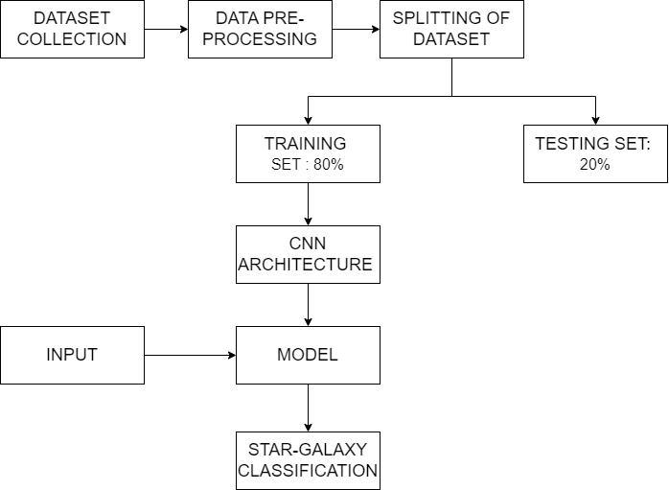
PIPELINE DIAGRAM

Slide 30
Model Building
1.import the libraries
2.design the architecture
3.model compilation
4.model training
5.saving the model

Slide 31
Model Building
The Convolution Neural Network is designed using the following layers:
1. Input Layer
2. Convolution Layer 1 (32 filters, 3x3 kernel, ReLU activation)
3. MaxPooling Layer 1 (2x2 pool size)
4. Convolution Layer 2 (64 filters, 3x3 kernel, ReLU activation)
5. MaxPooling Layer 2 (2x2 pool size)
6. Convolution Layer 3 (128 filters, 3x3 kernel, ReLU activation)
7. MaxPooling Layer 3 (2x2 pool size)
8. Flatten Layer
9. Dense Layer 1 (128 units, ReLU activation)
10. Dropout Layer 1 (50% rate)
11. Dense Layer 2 (64 units, ReLU activation)
12. Dropout Layer 2 (50% rate)
13. Output Layer (2 units, Softmax activation)

Slide 32
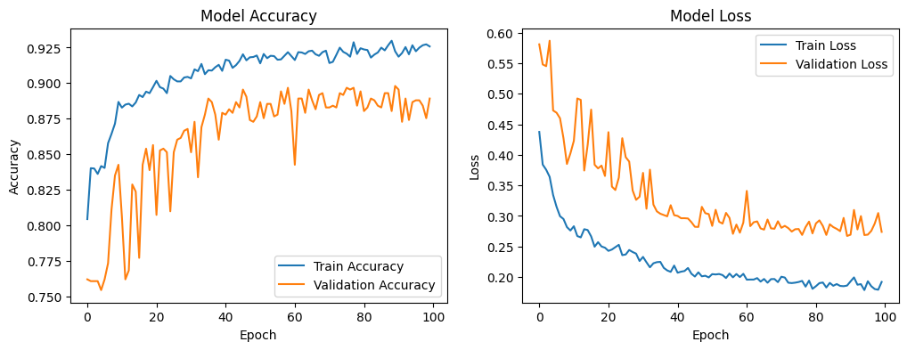
Learning Curve(50 epochs)
Test Accuracy : 0.8891687393188477 Training Accuracy: 93.15%
Test Loss : 0.2739414870738983 Training Loss: 18.24%

Slide 33
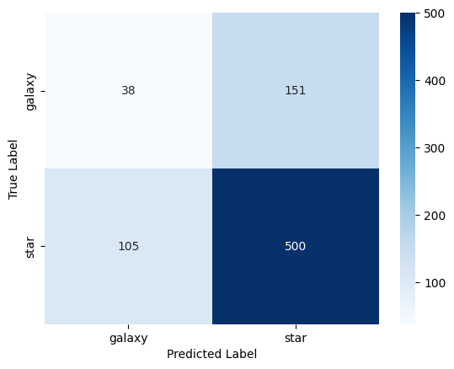
CONFUSION MATRIX

Slide 34
Evaluation Matrix
Metric | Galaxy | Star | Accuracy | Macro Average | Weighted Average
Precision | 0.27 | 0.77 |  | 0.52 | 0.65
Recall | 0.20 | 0.83 |  | 0.51 | 0.68
F1-Score | 0.23 | 0.80 | 0.68 | 0.51 | 0.66
Support | 189 | 605 | 794 | 794 | 794

Slide 35
INTERFACE
The interface is buid using python flask, HTML, CSS
The interface is a simple design
The home page consist of option to upload the the image by choosing the required image to classify
Then there is upload and predict button
The result page shows the input image and the predicted class and there is a button showing upload another image

Slide 36
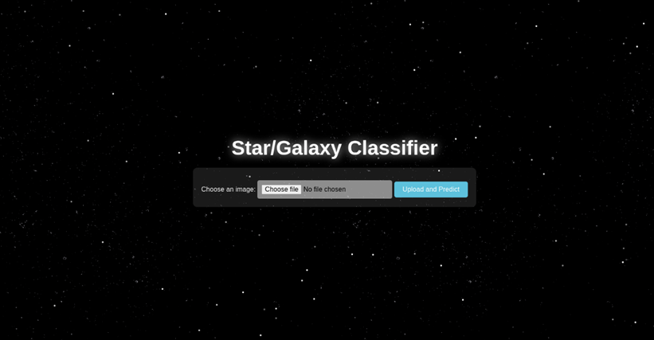
SCREEN SHOTS

Slide 37
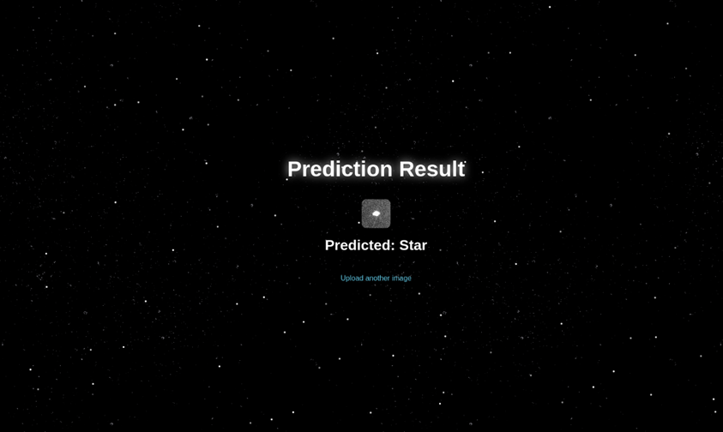

Slide 38
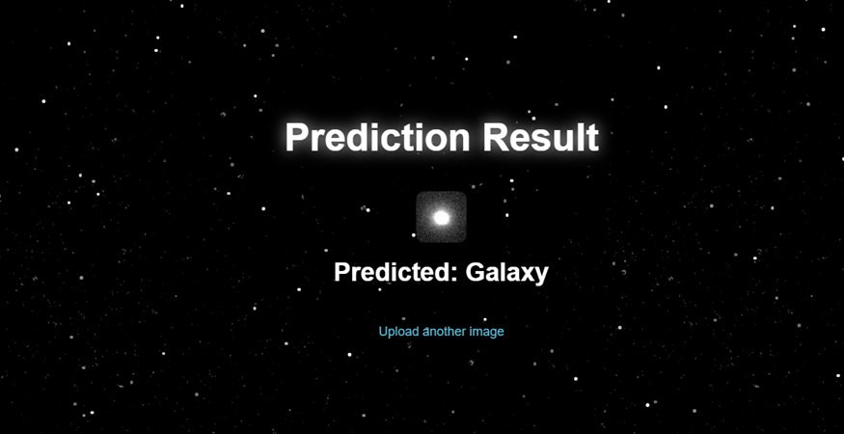

Slide 39
Thank
You

